Slide 1
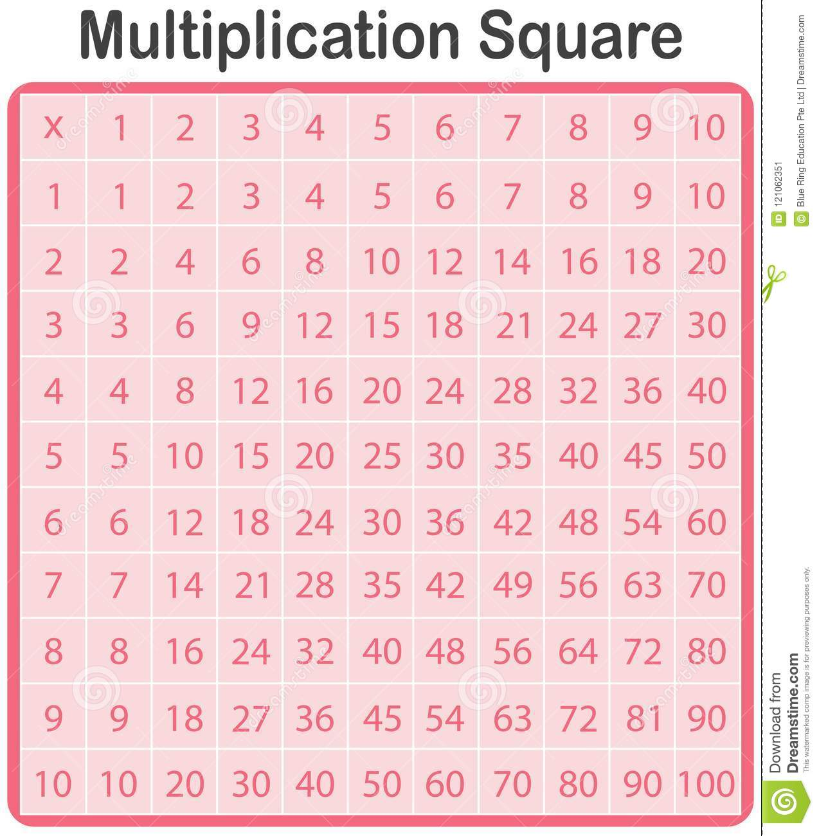
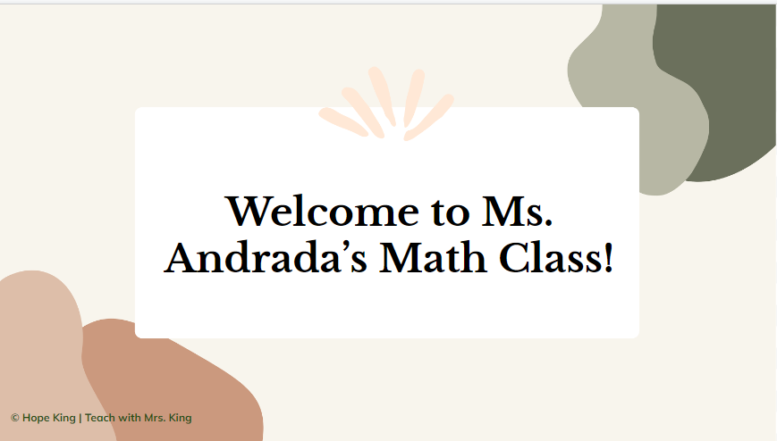
Pride Respect Acheivement
Bell Schedule
How to Tutorial Video's
Villa Non-Negotiables

